Slide 1

Components ,Data & Servers
Lesson 03
Notes:
Add instructor notes here.

Slide 2
Lesson Objectives
At the end of this module you will
be able to Learn:
The Server API
JSON endpoints
Loading state from the server
Perform the following functions under React Library-
React.createElement
ReactDOM.render
ReactDOMServer.renderToString
ReactDOMServer.renderToStaticMarkup
React.createClass
React.Children.count
React.Children.map
React.Children.forEach
Notes:
Add instructor notes here.

Slide 3
Server API
React maintains its own state, If you need too replicate the state in the server, we can also do that.
Here data is stored in json file, and kept in server folder
Similarly, create a folder client and write the respective codes
If we perform an operation on the react, state that we needed to be persisted, then we also need to notify the server of that state change, which makes 2 states sync
Server
Data.json
Home page
This.state
MyForm
Notes:
text/html endpoint
GET /
This entire time, server.js has actually been responsible for serving the app. When your browser
requests localhost:3000/, the server returns the file index.html. index.html loads in all of our
JavaScript/React code.
Note that React never makes a request to the server at this path. This is just used by the
browser to load the app. React only communicates with the JSON endpoints.
Slide explains that communication between service provider and consumer happen via SOAP messages

Slide 4
JSON endpoints
JSON is a format for storing human-readable data objects.
We can serialize JavaScript objects into JSON. This enables JavaScriptobjects to be stored in text files and transported over the network.
data.json is a JSON document.
data.json contains an array of objects. While not strictly JavaScript, the data in this array can be readily loaded into JavaScript.
In server.js, we see lines like this:
fs.readFile(DATA_FILE, function(err, data) {
const ti-mers = JSON.parse(data);
// ...
});
data is a string, the JSON. JSON.parse() converts this string into an actual JavaScript array of objects.
Notes:
GET /api/timers
Returns a list of all timers.
POST /api/timers
Accepts a JSON body with title, project, and id attributes. Will insert a new timer object into its
store.
POST /api/timers/start
Accepts a JSON body with the attribute id and start (a timestamp). Hunts through its store and
finds the timer with the matching id. Sets its runningSince to start.
POST /api/timers/stop
Accepts a JSON body with the attribute id and stop (a timestamp). Hunts through its store and finds
the timer with the matching id. Updates elapsed according to how long the timer has been running
(stop - runningSince). Sets runningSince to null.
PUT /api/timers
Accepts a JSON body with the attributes id and title and/or project. Hunts through its store and
finds the timer with the matching id. Updates title and/or project to new attributes.
DELETE /api/timers
Accepts a JSON body with the attribute id. Hunts through its store and deletes the timer with the
matching id.

Slide 5
REACT TOP-LEVEL API
React is entry point to React Library
React Top Level API helps us to create Components and helps us to render those components into DOM
Three libraries supports in achieving this
React
Contains API for Creating Components.
Component, PureComponent, CloneElement
PropTypes, Children, CreateClass, CreateFactory
ReactDOM
Contains API for rendering to the browser DOM
render, findDOMNode
ReactDOMSever
Contains API to render the components on the server
renderToString, renderToStaticMarkup
Notes:
Slide explains that communication between service provider and consumer happen via SOAP messages

Slide 6
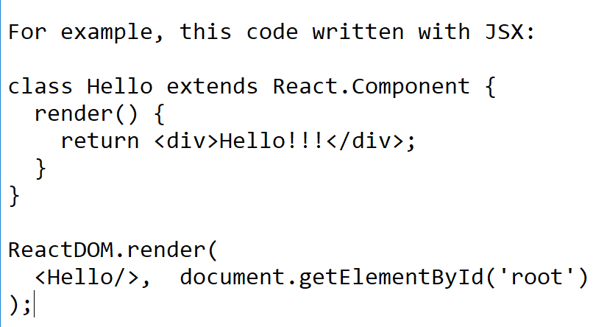
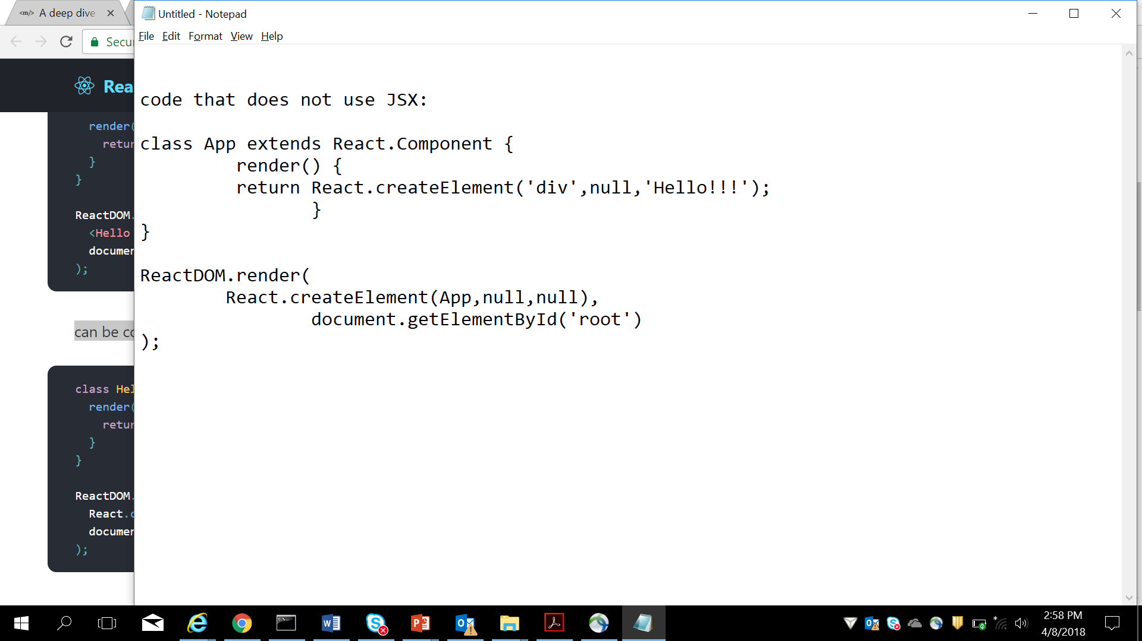
React.createElement
Create and return a new React element of the given type.
It is created using at least one, and optionally up to three, arguments to the function a string type, optionally an object props(attributes), and optionally children (text / element).
React.createElement( type, [props[, [children ...] );
Notes:
The type argument can be either a tag name string (such as 'div' or 'span'), a React component type (a class or a function), or a React fragment type.
Code written with JSX will be converted to use React.createElement(). You will not typically invoke
If you’re curious to see more examples of how JSX is converted to JavaScript, you can try out the online Babel compiler.
The component can either be provided as a string, or as a subclass of React.Component, or a plain function for stateless components.
If you get tired of typing React.createElement so much, one common pattern is to assign a shorthand:
const e = React.createElement;
ReactDOM.render( e('div', null, 'Hello World'), document.getElementById('root') );
The slide explains in brief, the components which make up the web service

Slide 7
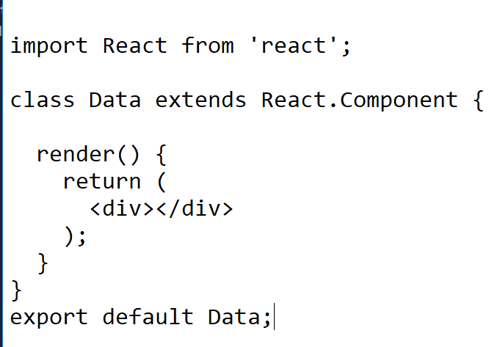

React.createClass
JavaScript didn't have classes,So React included its own class system from ES6, the latest version of JavaScript finalized in June 2015.
React.createClass allows you to generate component "classes."
React traditionally provided the React.createClass method to create component classes, and released a small syntax sugar update to allow for better use with ES6 modules by extends React.Component, which extends the Component class instead of calling createClass.
Notes:
The class syntax is not introducing a new object-oriented inheritance model to JavaScript. JavaScript classes provide a much simpler and clearer syntax to create objects and deal with inheritance.
If you don’t use ES6 yet, you may use the create-react-class module instead:
For implementing this create-react-class install first , using npm using following command
npm install create-react-class –-save . (note: you have to install this inside the project folder and -- save is used to store this dependency in package.json)
Then write the following code in index.js or any js file
var createReactClass = require('create-react-class');
var Sample = createReactClass(
{
render: function()
{
return <h1>Hello world , welcome to React</h1>;
}
}
);
ReactDOM.render(<Greeting />, document.getElementById('root'));
Slide explains about WSDL and UDDI registry.
Also explains regarding web service communication

Slide 8
React.Children
React.Children provides utilities for dealing with the this.props.children opaque data structure.
React.Children.map
React.Children.forEach
React.Children.count
React.Children.only
React.Children.toArray
Notes:
The basic structure of a React Child, that is a looks something like this:
{
$$typeof: Symbol(React.element),
key: null | key,
props: {},
ref: Function,
type: Function | Class | string,
}
Add instructor notes here.

Slide 9
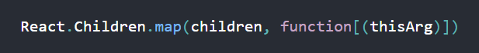
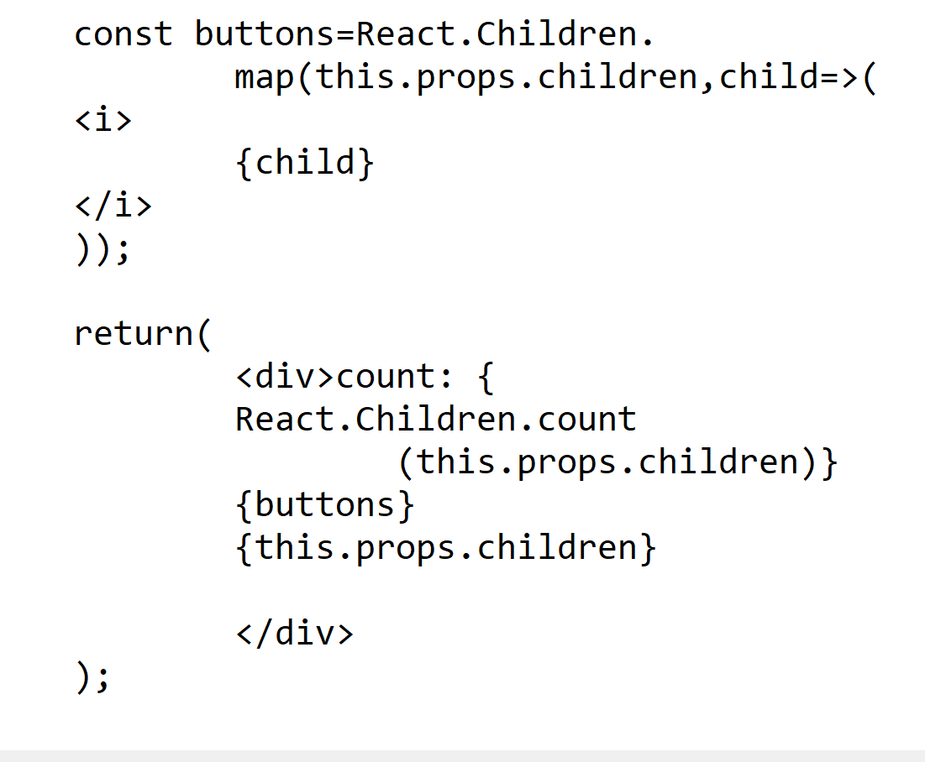
React.Children.map
It perform a function on each of the immediate children contained and will return an object
Notes:
Invokes a function on every immediate child contained within children with this set to thisArg.
If children is a keyed fragment or array it will be traversed: the function will never be passed the container objects.
If children is null or undefined, returns null or undefined rather than an array.

Slide 10
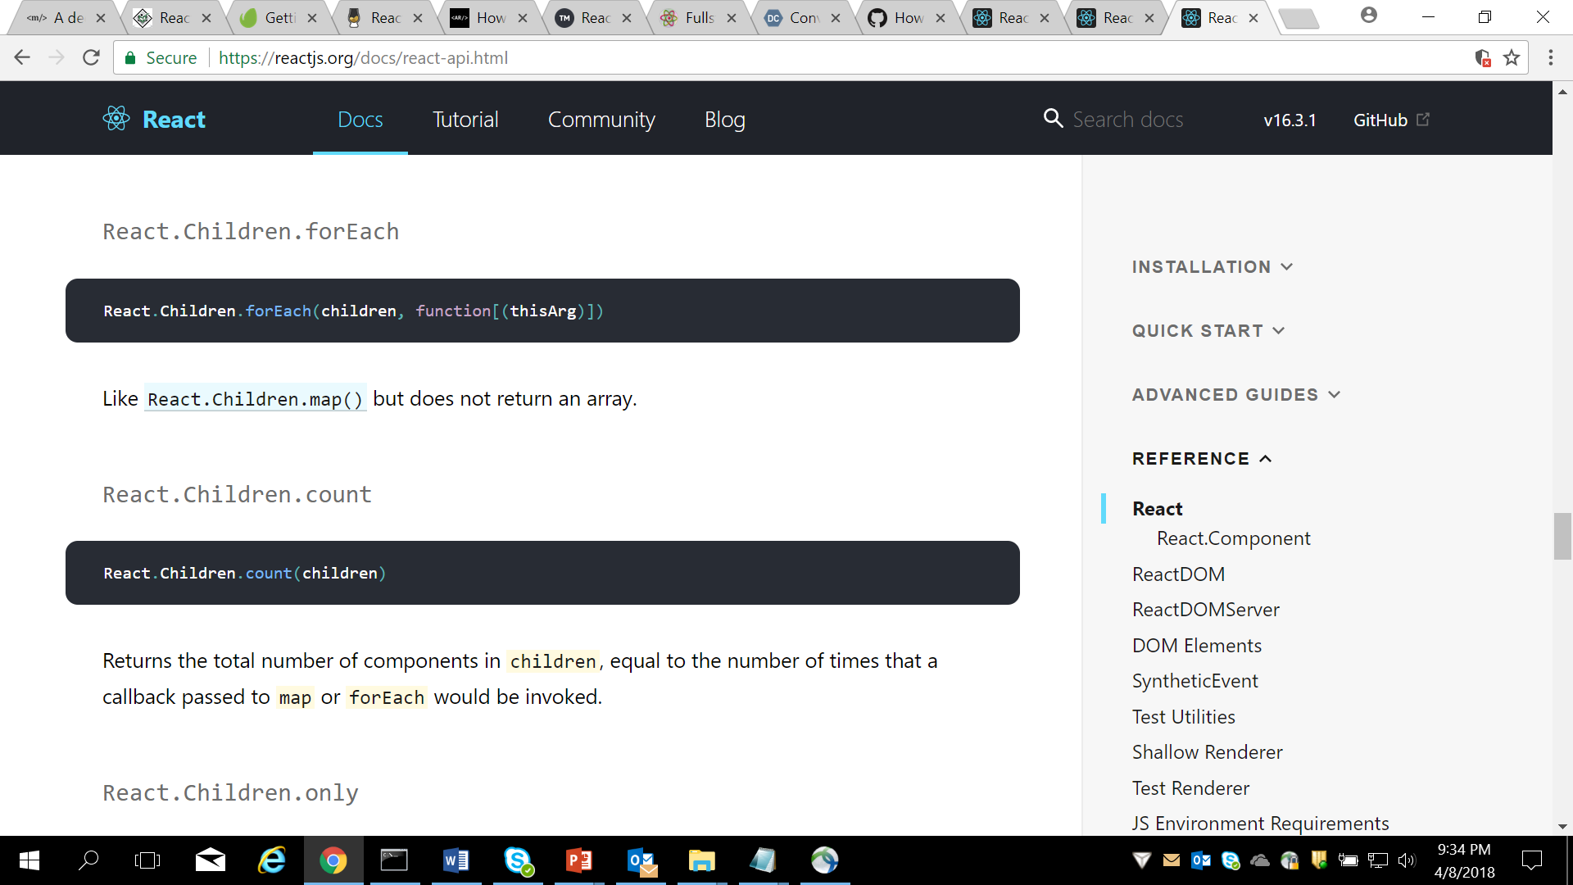
React.Children.count
The count method will return the number of components that are contained in element
The method accepts a single argument an object
Notes:
Invokes a function on every immediate child contained within children with this set to thisArg.
If children is a keyed fragment or array it will be traversed: the function will never be passed the container objects.
If children is null or undefined, returns null or undefined rather than an array.

Slide 11
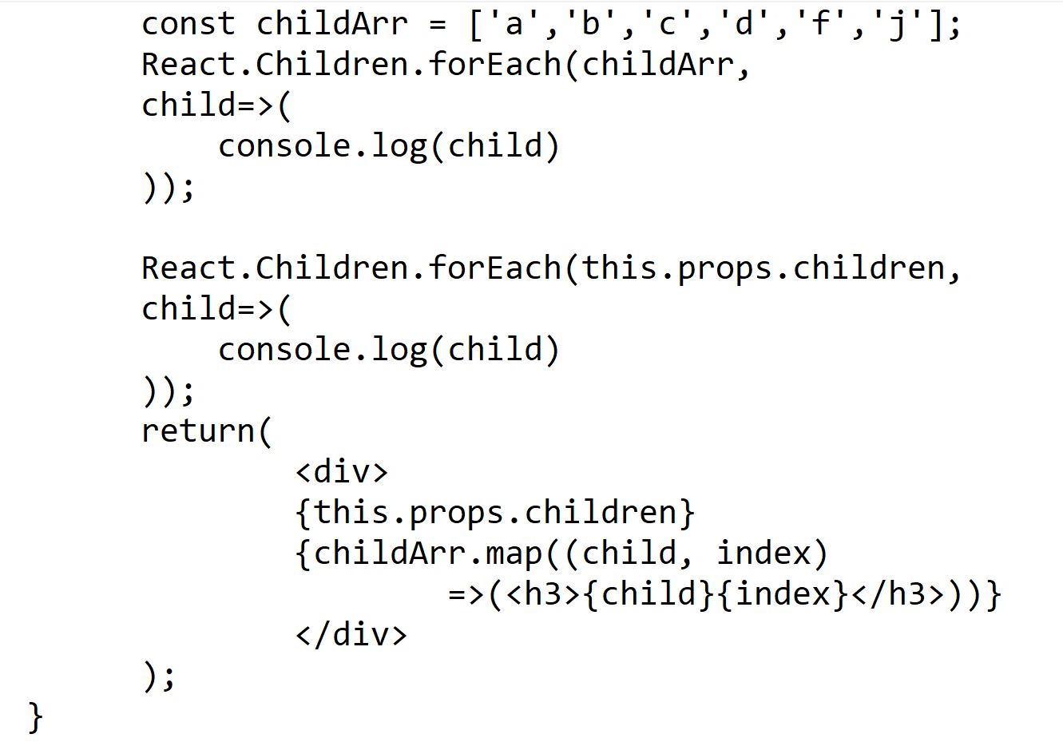
React.Children.forEach
It perform a function on each of the immediate children contained and will return an object
Notes:
Invokes a function on every immediate child contained within children with this set to thisArg.
If children is a keyed fragment or array it will be traversed: the function will never be passed the container objects.
If children is null or undefined, returns null or undefined rather than an array.

Slide 12
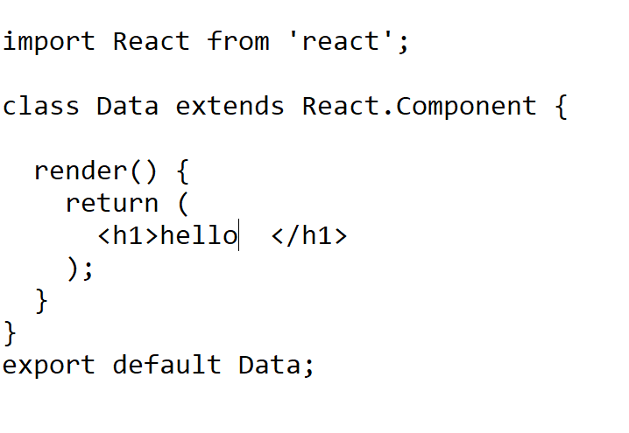
React Component
Components splits UI into independent unit
Components are reusable units
React.Component is available inside React API.
React Component classes are aviailable from Es6 only.
If you don’t use ES6 yet, you may use the create-react-class module instead.
Notes:
Invokes a function on every immediate child contained within children with this set to thisArg.
If children is a keyed fragment or array it will be traversed: the function will never be passed the container objects.
If children is null or undefined, returns null or undefined rather than an array.

Slide 13
Demo
Demos of
React.createClass
React.createElement
React.Children
React Component
Notes:
Add the notes here.
Add instructor notes here.

Slide 14
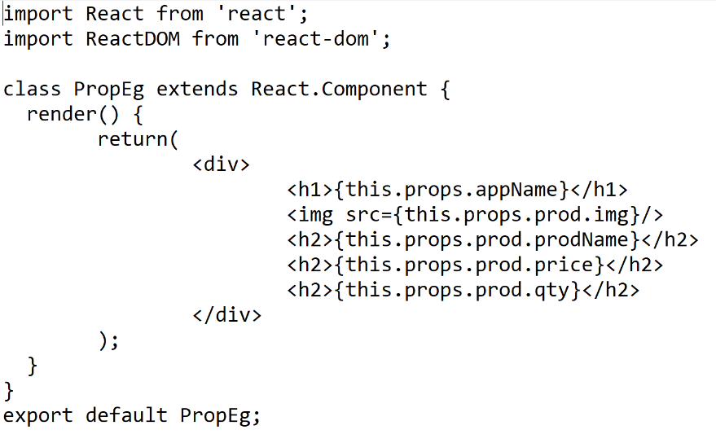
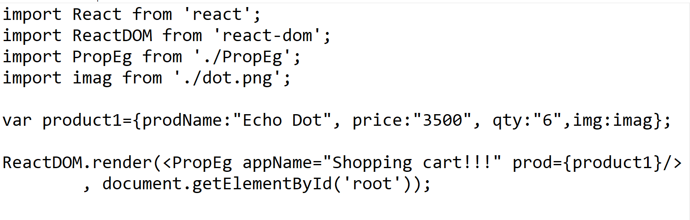
React Props
Props are nothing but properties which are single values or objects containing a set of values that are passed to React Components
Pass custom data to React Component
this.props contains the props that were defined by the caller of this component
Props are read Only
In PropEg.js file
In index.js file
Notes:
Once you store data in props cannot change the data, its read only info
Can be shared with other components also
Props without using jsx :
React.createElement(Hello, { alertNumber : 1 }, null);
Here we also pass null, which in this case indicates "empty" innerHTML. Or more precisely, no children.

Slide 15
PropTypes
React.PropTypes are used to run type checking on the props for a component.
Allows you to control the presence, or types of certain props passed to the child component.
defaultProps — Allows you to set default props for your component.
Validators can also be User defined
ParentComponent.defaultProps={
num:20
}
Notes:
React.PropTypes has moved into a different package since React v15.5. Please use theprop-types library instead.
PropTypes by passing them as an option to createClass():
const Component = React.createClass({ propTypes: { // propType definitions go here }, render: function() {} });
Eg:
const Component = React.createClass({ propTypes: { name: React.PropTypes.string }, // ... })
After Es6:
Defining propTypes in a class-based component using ES6 syntax is slightly different as it needs to be
defined as a class method on the component.
For below code to work use
npm install prop-types –save, inside the project folder
For example:
class Component extends React.Component {
render() {}
}
Component.propTypes = {/* definition goes here*/};
Example for ES6:
App.propTypes = { name: PropTypes.string };
------------------------------------------------------------------
This has to be written in index.js
ReactDOM.render(<ParentComponent num="10"/>, document.getElementById('root'));
In ParentComponent.js
ParentComponent.defaultProps={
num:20
}
If num is not there in ParentComponent in above snippet ,then it takes value given by defaultProps, and out will be printing 20
ReactDOM.render(<ParentComponent num="10"/>, document.getElementById('root'));
if it is given then it takes 10 ,as given in above code snippet.
There is a problem in above code snippet, we have passed 10 as string so when it goes to expression in ParentComponent and doesn’t add two numbers ,but it concatenates to give output as 510, instead of 15.

Slide 16
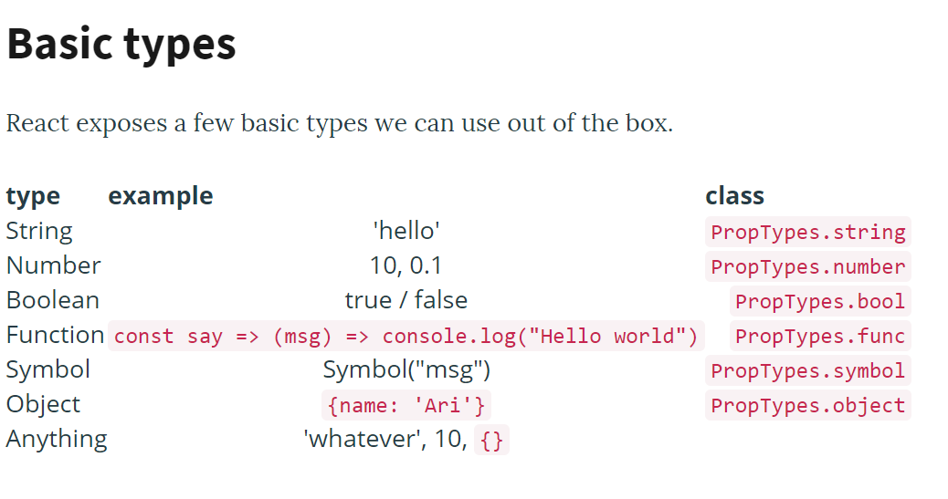
PropTypes
Its moved to prop-types library since React v15.5.So for import use,
import PropTypes from 'prop-types';
The React.PropTypes object contains a list of built-in validators.
They are like
String , Number, Function, Boolean, Object , shape, oneof, instanceof, array, arrayof ,node, element, any, required
Notes:
As see in previous slide about defaultProps, there is one more problem in using proptyes, what if data type passed is different from what it has to be actually passed with respect to the logic, this was also discussed in previous slide. And Solution for it is discussed here
How to check the type being passed from parent to child
Employee.propTypes = {
firstName: PropTypes.string,
empId: PropTypes.number,
status: PropTypes.bool,
onDisplay: PropTypes.func,
symbol: PropTypes.symbol,
user: PropTypes.object,
name: PropTypes.node
}
===================================================================
In Employee.js:
Employee.propTypes = {
firstName: PropTypes.string.isRequired
}
If isRequired is used along with any of the above propTypes, then will get warning as below
Warning: Failed prop type: The prop `firstName` is marked as required in `Employee`, but its value is `undefined`. in Employee (at Employee.js:10)
NOTE: ensure defaultProps is not defined for that element , else required wont have an impact
--------------------------------------------------------------------------------------------------
We can also require that an array holds only objects of a certain type using PropTypes.arrayOf([]).
Type example class
Array [] PropTypes.array
Array of numbers [1, 2, 3] PropTypes.arrayOf([type])
Enum ['Red', 'Blue'] PropTypes.oneOf([arr])
--------------------------------------------------------------------------------------------------
It's possible to define types that need to be of a certain shape or instance of a certain class
Type example class
Object {name: 'Ari'} PropTypes.object
Number object {count: 42} PropTypes.objectOf()
--------------------------------------------------------------------------------------------------
We can also pass through React elements from a parent to a child. This is incredibly useful for building templates and providing customization with the templates.
Type example class
Element <Title /> PropTypes.element

Slide 17
Demo
Demos of
React props
React PropTypes
Notes:
Add the notes here.
Add instructor notes here.

Slide 18
Context
Context provides a way to pass data through the component tree without having to pass props down manually at every level.
This is called as props-drilling
MyTag
Head
Title
props
props
props
Index includes MyTag component
index
Second
Tag
Here index,MyTag,SecondTag,head,title are component js files
Props has to be carry forwarded from MyTag to Head, Head to Title(props-drilling)
React’s context API gives you a solution for props –drilling , instead of passing down the props explicitly down to each component you can store the data needed by every Component in React’s context and pass them to all other components implicitly.
If a component needs access to the context, it can consume it on demand.
Notes:
Passing props down the component tree - Props drilling
Context provides a way to share values like this between components without having to explicitly pass a prop through every level of the tree.

Slide 19
Context continued…
After usage of react’s Context Api
MyTag
Provides Context
(common data)
Head
Title
Index includes MyTag component
index
Second
Tag
Here index,MyTag,SecondTag,head,title are component js files
MyTag stores the common data in context and are utilized by head and Title components
When to Use Context
Context can be used when data that can be considered “global” for a tree of React components. such as the current authenticated user, theme(css), company details or preferred language.

Slide 20
Context Continued….
React Context has 2 components
Consumer
Provider
To access these 2 components, we have to create Context object
createContext()
const GradeContext = React.createContext(‘grades’);
Consumer :
<ThemeContext.Provider value={'green'}>
<D />
</ThemeContext.Provider>
Provider:
<ThemeContext.Consumer>
{coloredTheme =>
<div style={{ color: coloredTheme }}>
Hello World
</div> }
</ThemeContext.Consumer>
Notes:
For create Context() method , there is single argument :
the initial value is can be null, or if you need a default value provide it as argument.
React.createContext(null);
The value is set to null, so later we can set the value
React.createContext(‘grades’); -→ here grades is considered as initial value
Context is similar to props except that a change in context doesn't actually trigger a render. Usually context takes its value from a state or a store so that's usually not a problem. Another downside is unlike props, React doesn't provide a way to set a default value for it.
Validasting child context Types:
// Define types of elements in context // We define it the same way as `propTypes` childContextTypes: { eventBus: React.PropTypes.object.isRequired },

Slide 21
Demo
Demos of
React Context Api
Notes:
Add the notes here.
Add instructor notes here.

Slide 22
Summary
By now you would have got clear idea of
React Top level Api
React Children
React Component
Props
PropTypes
Context
Notes:
Add the notes here.
Add instructor notes here.

Slide 23
Review Questions
Question 1:
_______question 1
A)
B)
C)
D)
Question 2:
q2
A)
B)
C)
D)

